Slide 1
PhD Defense – Tuesday, July 11, 2023
LARGE EDDY SIMULATIONS TO INVESTIGATE THE FUNDAMENTAL FLOW PHYSICS OF SUPERCRITICAL CARBON DIOXIDE TURBULENT JETS
Julia Ream
Co-Advisors: Dr. Mark Sussman and Dr. Marc Henry de Frahan

Slide 2
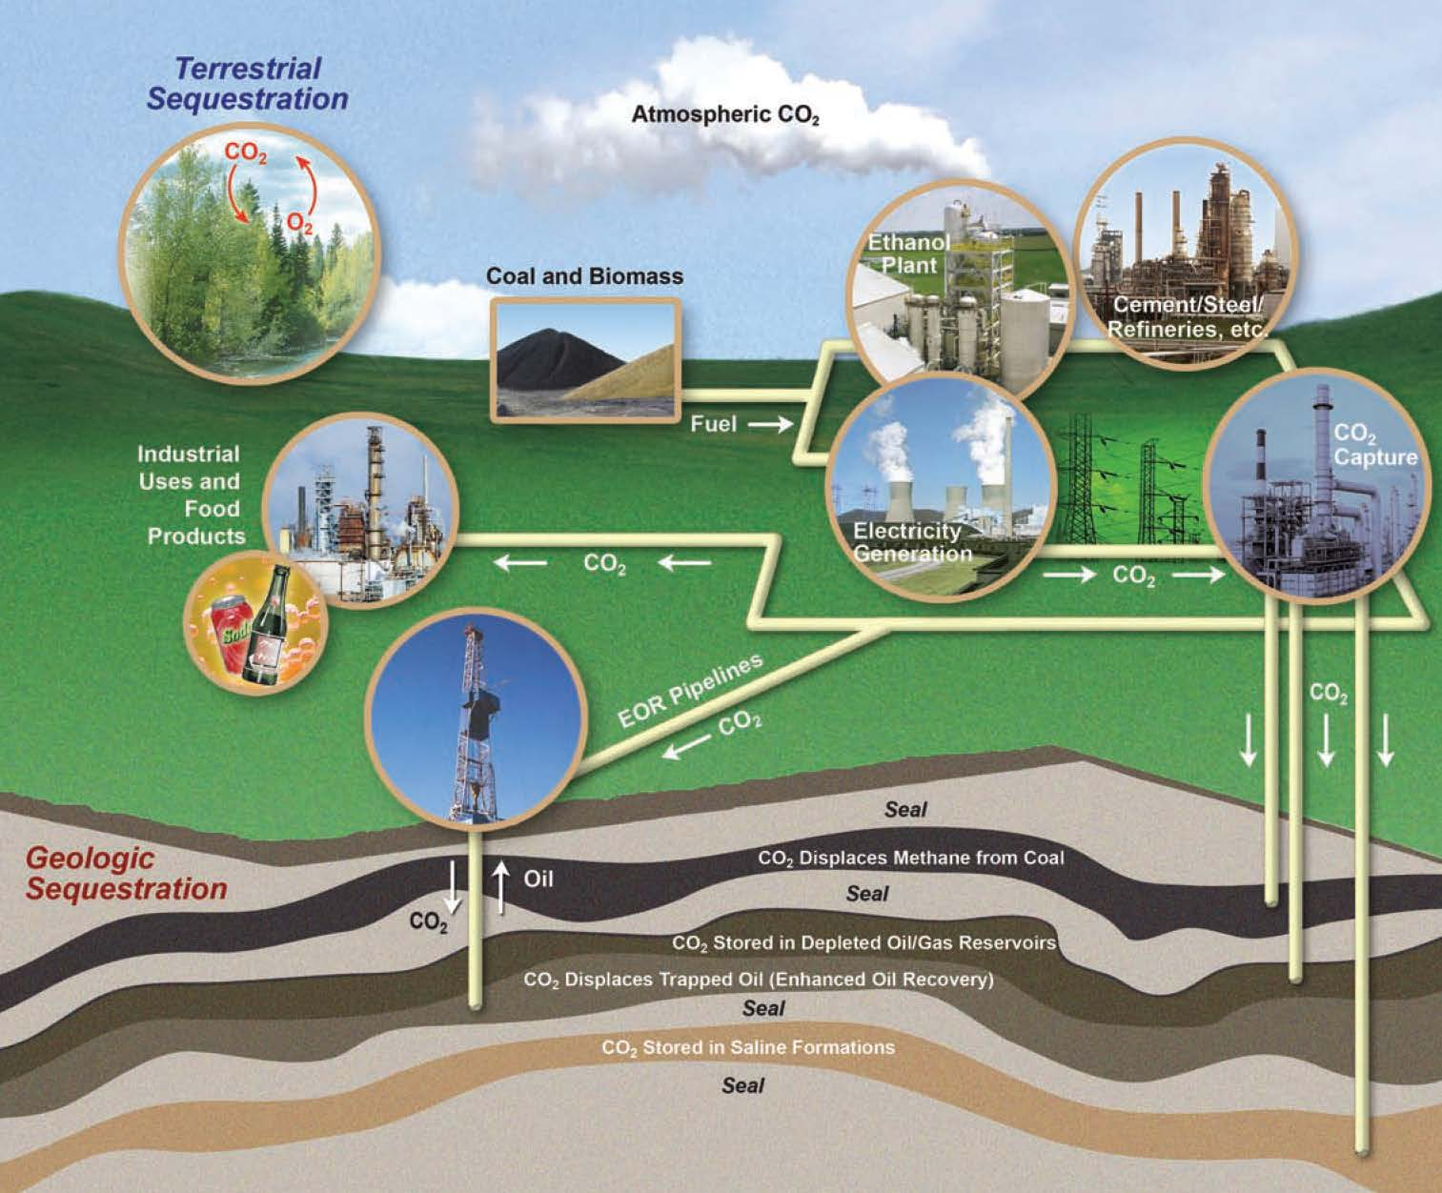
Motivation
Carbon Dioxide (CO2) = primary greenhouse gas emitted through human activity
More greenhouse gases => more heat retention…
Fig. 1: Examples of Geologic Carbon Sequestration
The Trustees of Indiana University. 2019. Geological Sequestration. Retrieved from https://igws.indiana.edu/Sequestration

Slide 3
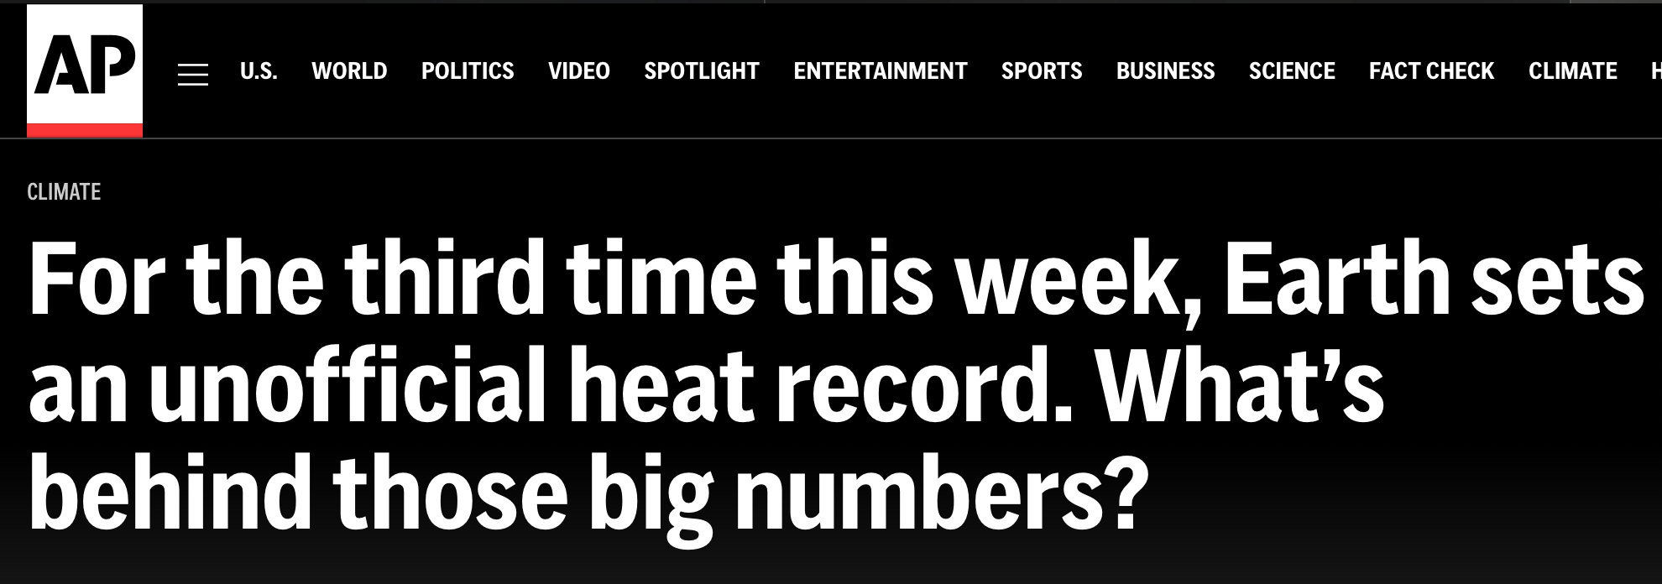
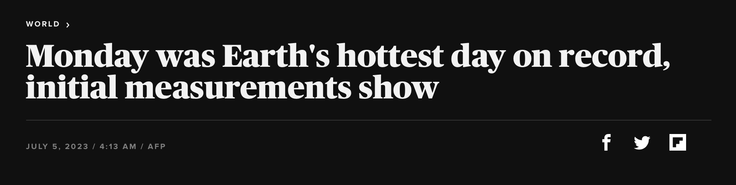
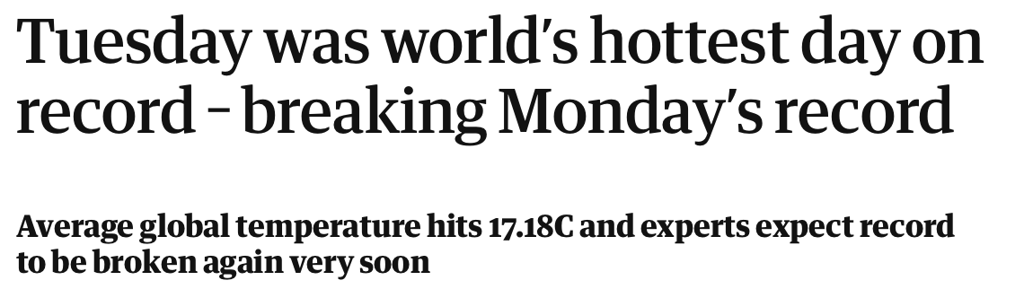
Motivation

Slide 4
Motivation
Carbon Capture and Sequestration: Take CO2 runoff and put it somewhere else
Lots of promising and beneficial applications for CO2 in its supercritical form (sCO2)
Fig. 1: Examples of Geologic Carbon Sequestration
The Trustees of Indiana University. 2019. Geological Sequestration. Retrieved from https://igws.indiana.edu/Sequestration

Slide 5
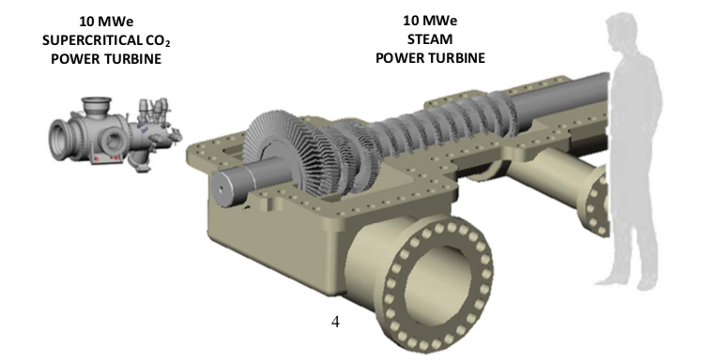
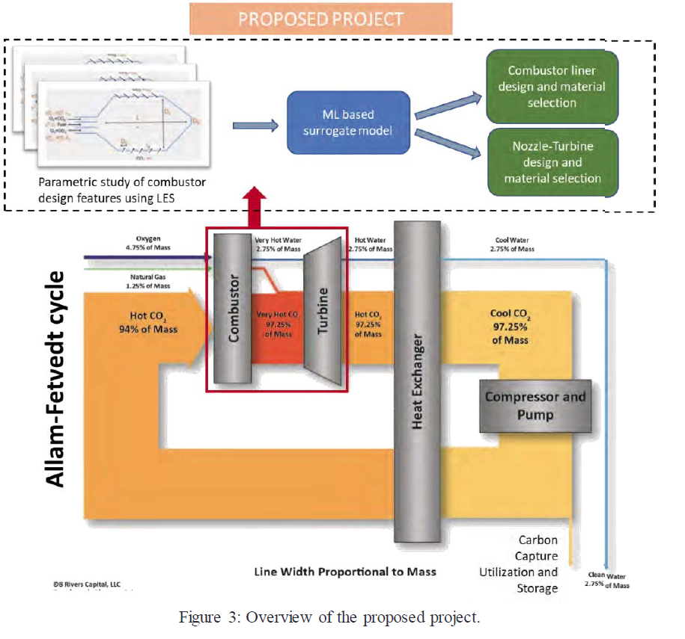
Applications of Interest
Advanced Cycles for Power Generation
Fig. 2a: 10 MWe sCO₂ power turbine compared to a 10 MWe steam turbine
Fig. 2b: Overview of project with 8Rivers Capital: https://hpc4mtls.llnl.gov/projects.html
Persichilli, M., Kacludis, A., Zdankiewicz, E., & Held, T. (2013). Supercritical CO₂ Power Cycle Developments and Commercialization: Why sCO₂ can Displace Steam. Power-Gen India & Central Asia. Echogen Power Systems LLC. https://www.echogen.com/documents/why-sco2-can-displace-steam.pdf.

Slide 6
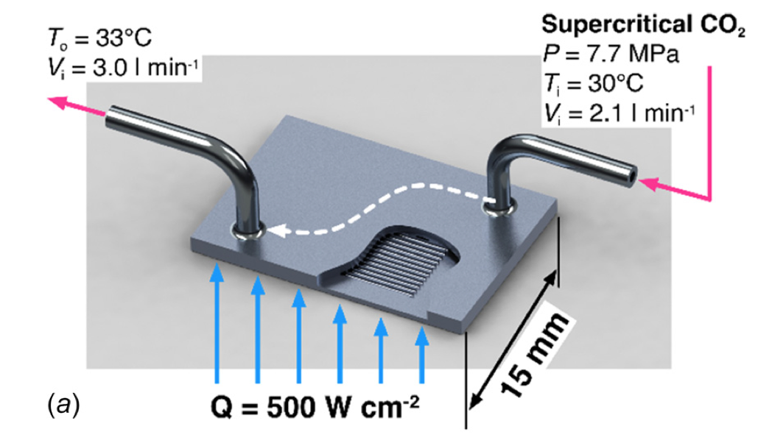
Applications of Interest
Advanced Cycles for Power Generation
High Flux Thermal Management
Fig. 3: Another promising application of sCO₂ is in high flux thermal management.
Fronk, B. & Rattner, A. . (2016). High-Flux Thermal Management with Supercritical Fluids. Journal of Heat Transfer. pp. 124501-1-4. 138. 138(12). https://doi-org.proxy.lib.fsu.edu/10.1115/1.4034053
National Academies of Sciences, Engineering, and Medicine. 2020. Advanced Technologies for Gas Turbines. Washington, DC: The National Academies Press. https://doi.org/10.17226/25630.

Slide 7
Challenges
Experimental and numerical challenges due to extreme operating conditions and sensitive parameter regime
Focuses on application-specific quantities of interest as opposed to general underlying physics

Slide 8
Project Scope
Goal: simulate flow field of turbulent sCO₂ jet in order to gain better understanding of underlying physics in the pseudocritical zone, specifically around the pseudo-boiling point
Our hypothesis is that supercritical flows for canonical round turbulent jets exhibit different physical mechanisms than those of ideal gas.
Understanding base mechanisms of supercritical flows can add to theory related to quantities of interest across all applications

Slide 9
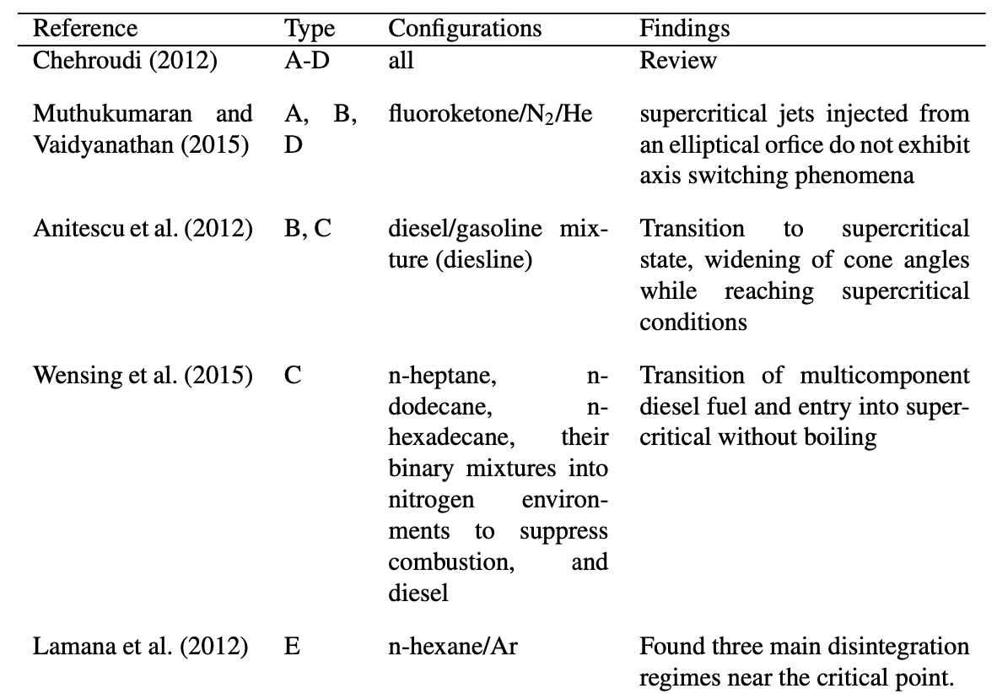
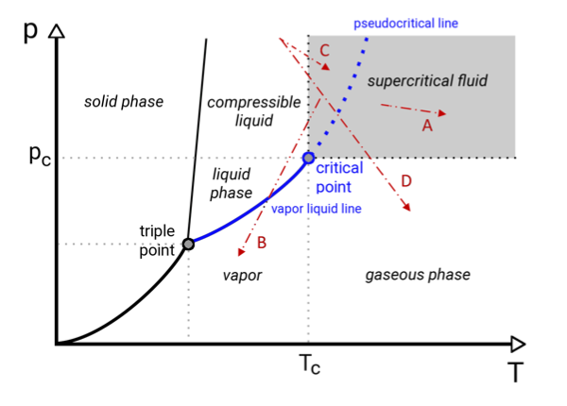
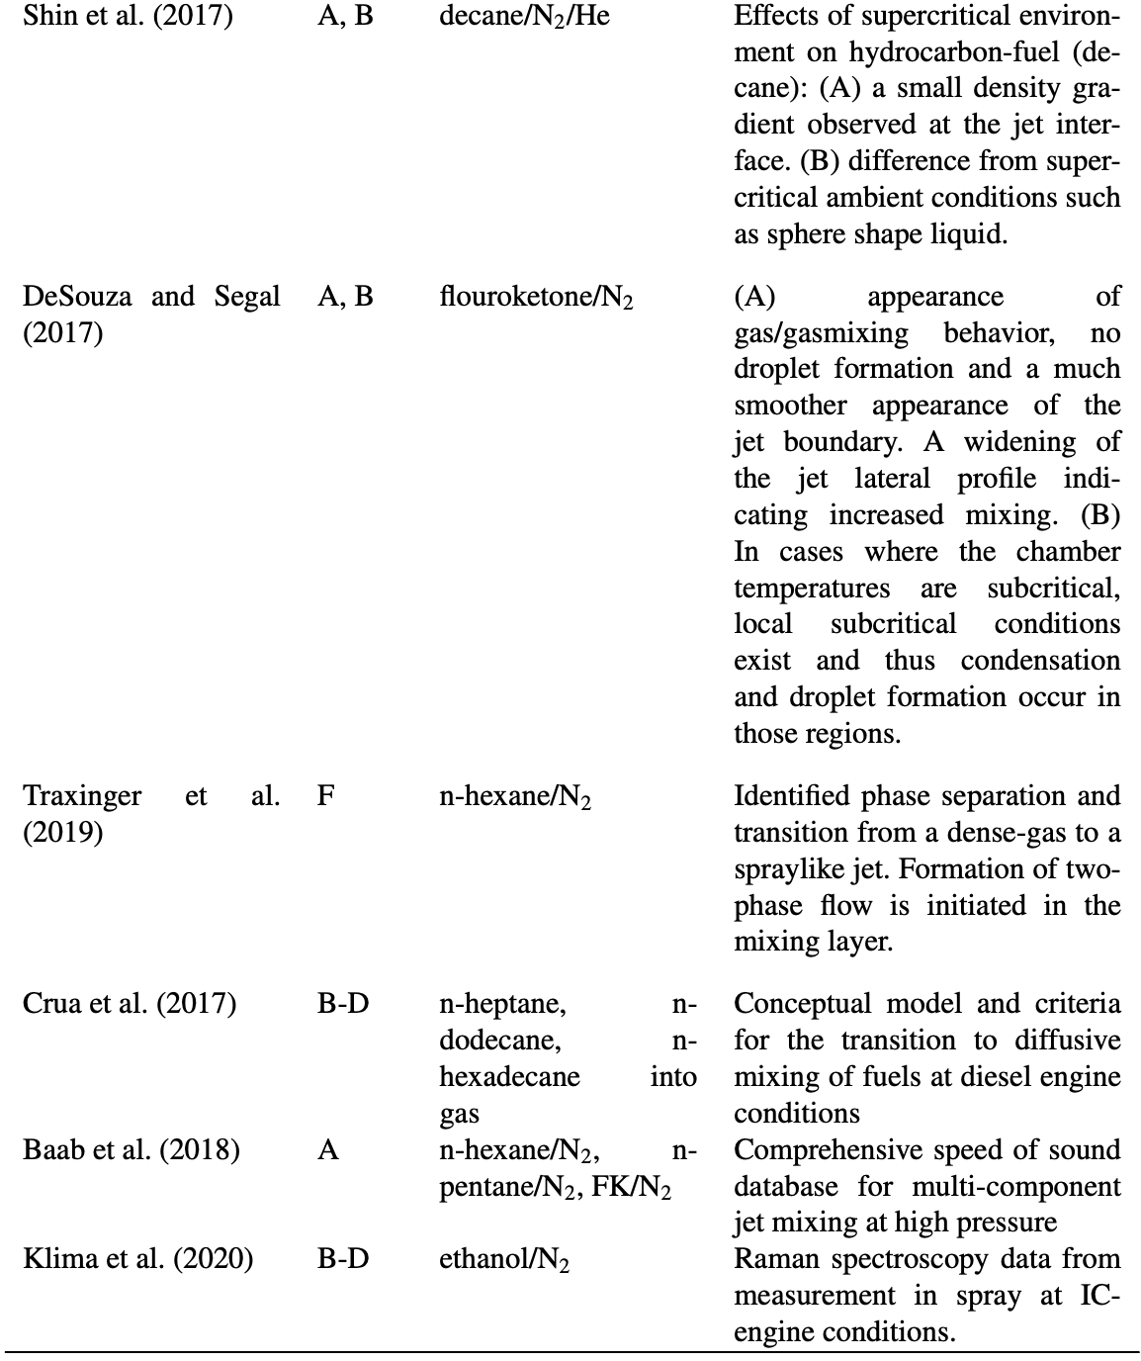
Experimental Research Overview
Ries, F. Sadiki, A. (2021). “SUPERCRITICAL AND TRANSCRITICAL TURBULENT INJECTION PROCESSES: CONSISTENCY OF NUMERICAL MODELING.” Atomization and Sprays 31(5): 37-71

Slide 10
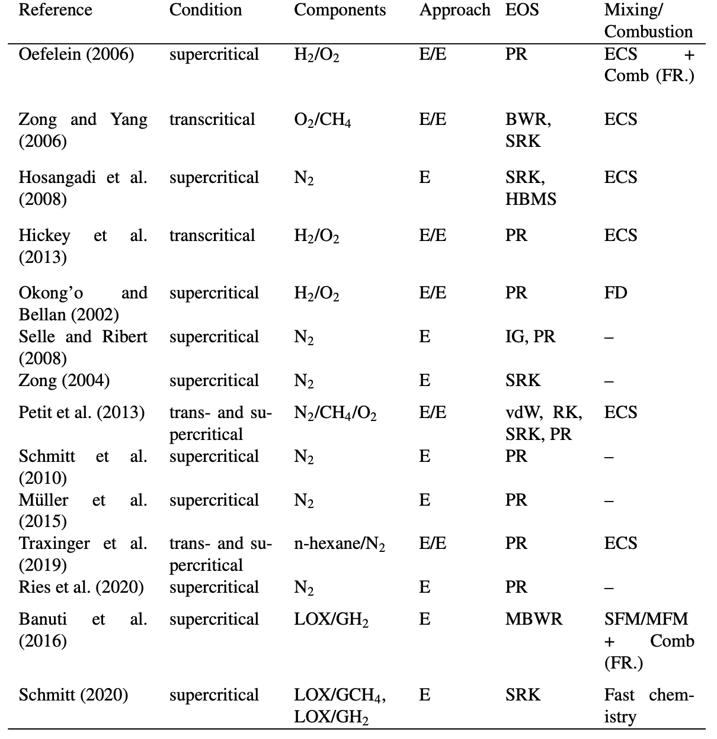
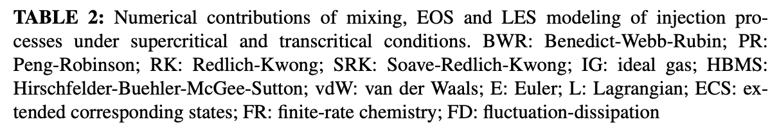
Numerical Research Overview
Ries, F. Sadiki, A. (2021). “SUPERCRITICAL AND TRANSCRITICAL TURBULENT INJECTION PROCESSES: CONSISTENCY OF NUMERICAL MODELING.” Atomization and Sprays 31(5): 37-71

Slide 11
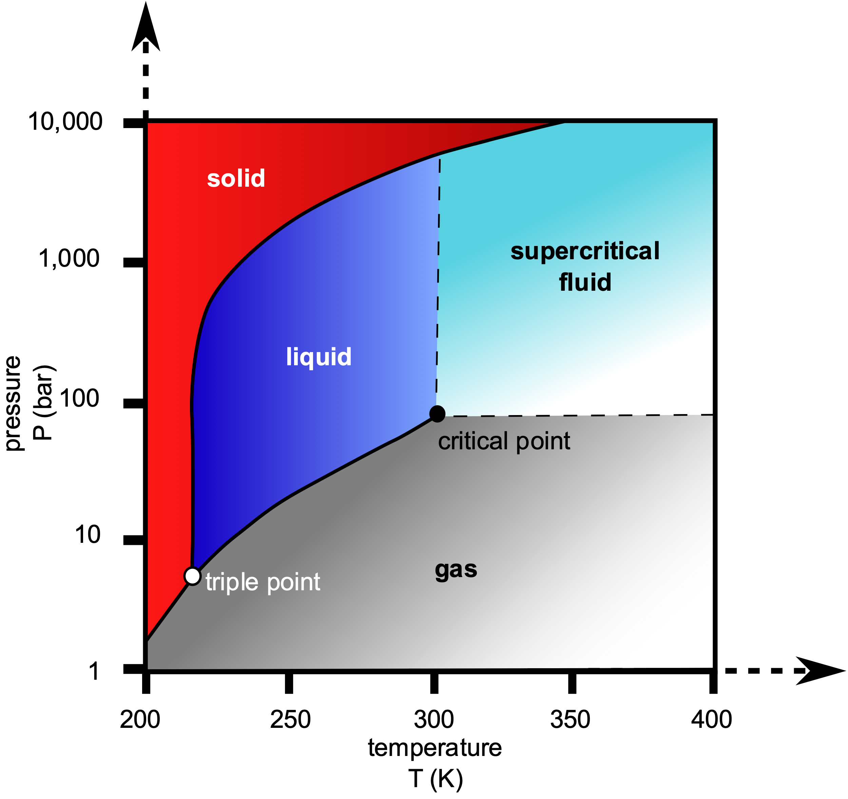
What are supercritical fluids?
We will be focusing on this pseudocritical region
Fluids held above critical temperature and pressure
Liquid-like density + Gas-like viscosity
Sensitive density, pressure, temperature relationship
Critical point for CO₂: T=304 K, P=7.38 MPa
Fig. 4: Phase Diagram for Carbon Dioxide
Finney, B. & Jacobs, M. (2010). Carbon dioxide pressure-temperature phase diagram.svg. Retrieved from https://commons.wikimedia.org/wiki/File:Carbon_dioxide_pressure-temperature_phase_diagram.svg.

Slide 12
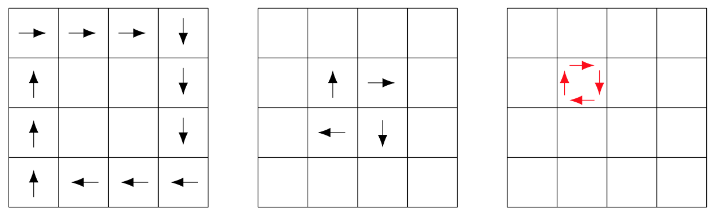
What is a Large Eddy Simulation?
LES assumes decomposition of flow into spatially filtered vs. residual components:

Slide 13
Governing Equations
Filtered Compressible Navier-Stokes Equations (NSE)
Favre Filtering:
Diffusive Fluxes:
Need to be modeled
Note: grid serves as filter for advanced terms; LES filter used for SGS models

Slide 14
Governing Equations
Filtered Compressible Navier-Stokes Equations (NSE)
SGS stress:
SGS heat flux:
SGS turbulent diffusion:
Need to be modeled

Slide 15
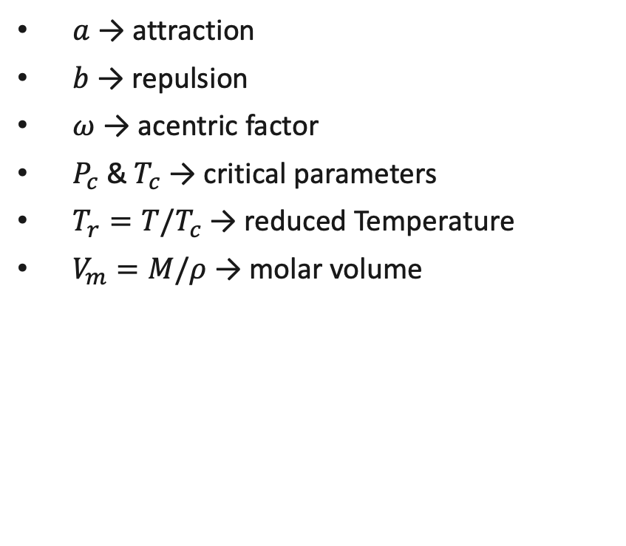
Governing Equations
Soave-Redlich-Kwong Equation of State (SRK)
$a$ → attraction
$b$ → repulsion
$ω$ → acentric factor
$P_{c}$ & $T_{c}$ → critical parameters
$T_{r}=T/T_{c}$ → reduced Temperature
$V_{m}=M/ρ$ → molar volume
Thermo properties can be divided into ideal vs. departure function:
Needs to be modeled
Calculated via SRK
Gallagher, B. (2012). “Equation of State Unit”. Retrieved from http://flash.uchicago.edu/~jbgallag/2012/flash4_ug/node22.html#SECTION06310000000000000000.
Soave, Giorgio (1972). "Equilibrium constants from a modified Redlich-Kwong equation of state". Chemical Engineering Science. 27(6): 1197–1203. doi:10.1016/0009-2509(72)80096-4.

Slide 16
Model Overview
SGS stress → Dynamic Smagorinsky (Lilly, 1992)
SGS heat flux → Eddy-Diffusivity Model (Martín et al., 2000)
SGS turbulent diffusion → (Knight et al., 1997)
Transport Coefficients → EGLib Functions (Ern and Giovangigli, 1995) + High Pressure Corrections (Chung et al., 1988)
Ideal Thermodynamic Components → NASA Polynomial Fits (McBride et al., 2002)
Transport & Thermo take into consideration deviation from ideal
SGS terms & LES assume ideal conditions only → room for improvement

Slide 17
Model Validation
Worse approximation near pseudo-boiling point but overall general good agreement with NIST data

Slide 18
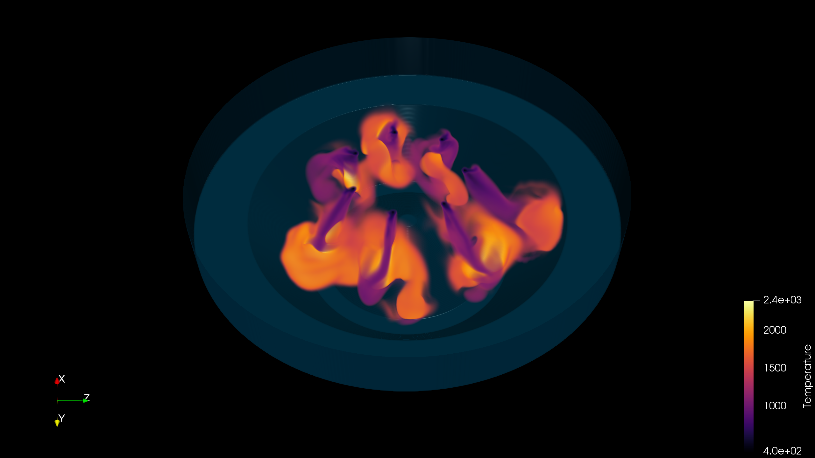
PeleC
Built on AMReX and funded by the Exascale Computing Project (ECP) through the Department of Energy (DOE), PeleC is an adaptive-mesh compressible hydrodynamics code for reacting flows
Models turbulence-chemistry interactions motivated by conditions in internal combustion engines
Can additionally handle embedded boundary conditions, non-ideal EoS, and allows for implementation of adaptive mesh refinement (AMR)
Utilizes 2nd order finite volume formulation
To learn more visit: https://github.com/AMReX-Combustion/PeleC
Fig 5: Injection of natural gas in a piston-bowl geometry performed using PeleC
. PELEC. Computer software. https://www.osti.gov//servlets/purl/1374142. Vers. 00. USDOE Office of Science (SC), Advanced Scientific Computing Research (ASCR) (SC-21). 17 May. 2017. Web.

Slide 19
Numerical Methods
Temporal Discretization – Spectral Deferred Correction Methods
approximated by
Solution:
Can be iteratively updated using a residual and error term:
Low order discretization
High order quadrature

Slide 20
Numerical Methods
Temporal Discretization – Spectral Deferred Correction Methods
Flux terms can be further split into Advection (A), Diffusion (D), and Reaction (R) components:
Key benefits: operator splitting helps with managing stiff components of system (usually Reaction terms but not including reactions for now) and quadrature choice determines order of accuracy (2nd order here) even with lower order discretization

Slide 21
Numerical Methods
Spatial Discretization – Flux Calculations
Diffusion (D)
2nd order center differencing in space and time
Advection (A)
Piecewise Parabolic Method (Colella & Sekora, 2008) → Project cell-centered values to cell-edges, centered in time
Approximate Riemann Solver (Colella & Glaz, 1985) Takes time-centered cell-edge values to calculate Fluxes
Key Benefits: PPM includes extreme slope limiting to help with steep density gradients;

Slide 22
Schematic
Outlet Condition
Buffer Zone
3D Simulation
Slice at z=0 for visualizations
Buffer zone implemented with adaptive mesh refinement (AMR)
Ambient temperature and pressure set to match inlet condition
# of cells on coarse grid (x ,y, z):
80, 200, 80
AMR max level: 4
Refine when vorticity_{ERR} > 5000
62.5d
60d
y
Jet Inlet Condition diameter (d) = .01 cm
z
x
20d
25d

Slide 23
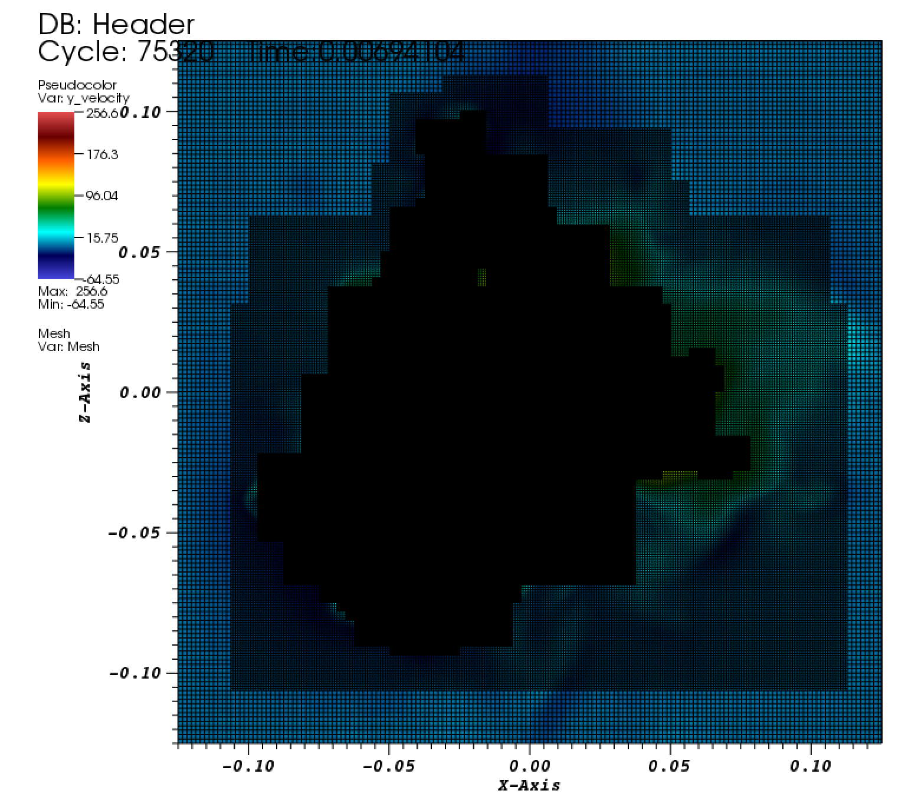
Performing LES in HPC environment
Simulations utilize 576 MPI Ranks
36 ranks per node across 16 nodes
Roughly 17k cells per MPI Rank
Each plot file contains approximately 34 GB of data
We use the NREL Eagle supercomputer to perform simulations
PeleC has been shown to scale very well on this system and other HPC systems (e.g. ORNL Summit)
Dynamic load balancing of AMR levels allows for maximum utilization of the system
The Intel suite of compilers was used

Slide 24
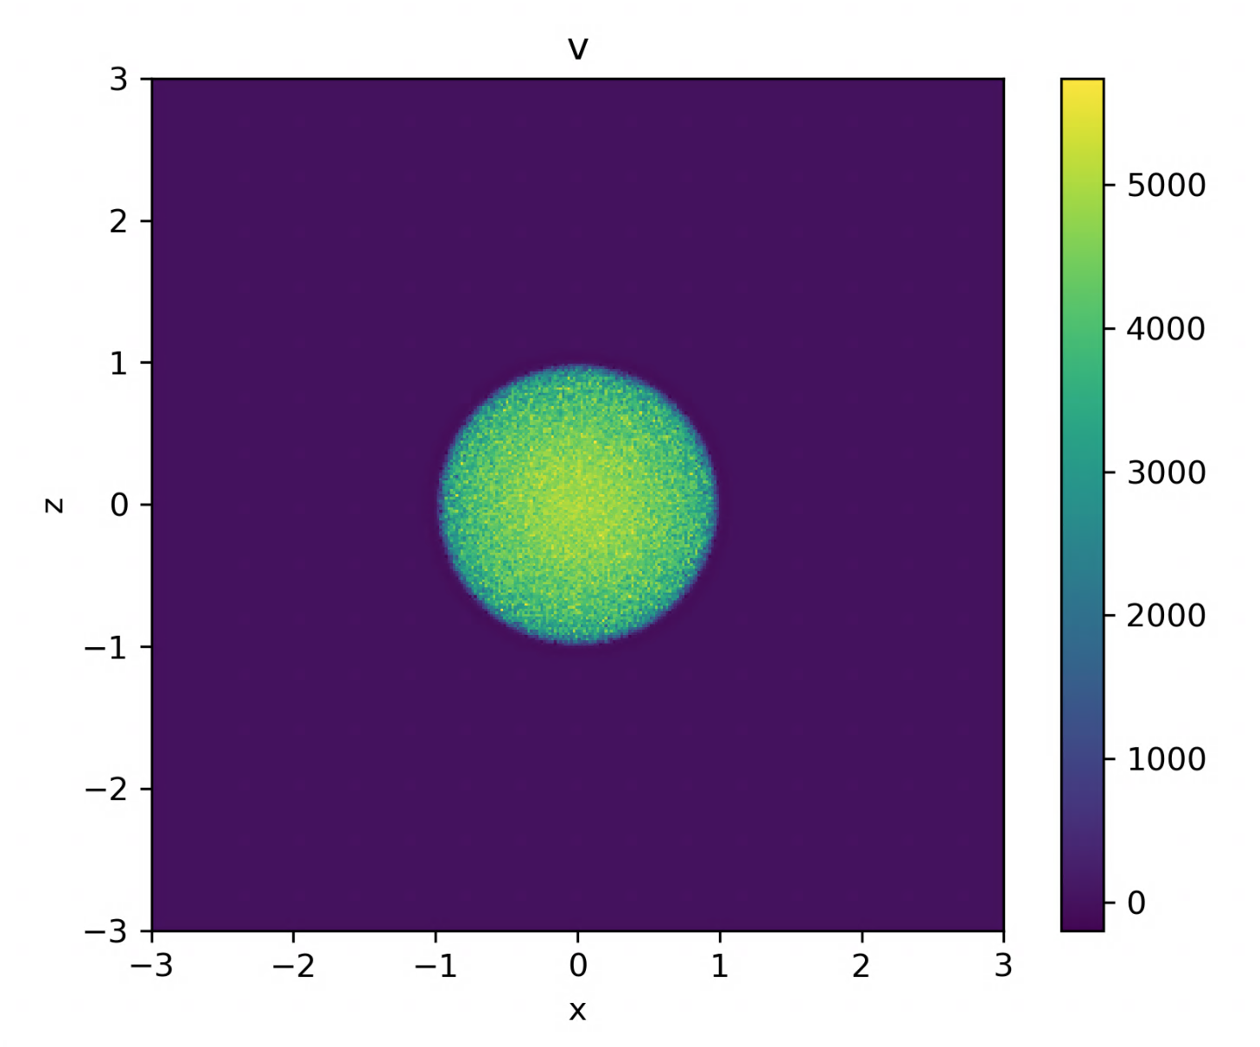
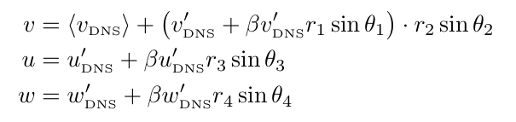
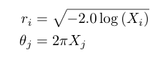
Boundary Conditions
Inflow
diameter = .01 cm
input velocity scaled to predetermined mean velocity + noise scaled by r.m.s. profiles calculated via direct numerical simulation (DNS)
Outflow
First order extrapolation to impose zero gradient at boundary
Do not implement AMR at boundary

Slide 25
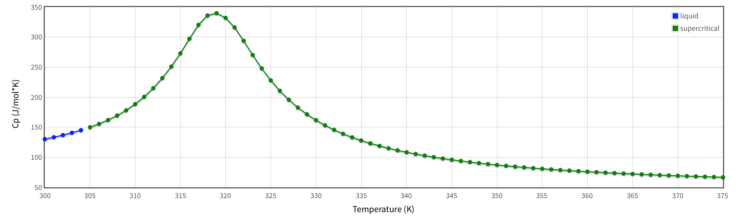
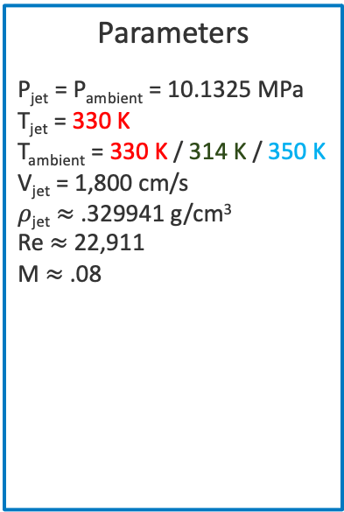
Exploring Injections Near the Pseudocritical Point
We want to look at cases near the critical point to study large changes in specific heat
Case 1: T_{ambient} = T_{jet}
Case 2: T_{ambient} < T_{jet}
Case 3: T_{ambient} > T_{jet}
Parameters
P_{jet} = P_{ambient} = 10.1325 MPa
T_{jet} = 330 K
T_{ambient} = 330 K / 314 K / 350 K
V_{jet} = 1,800 cm/s
$ρ$_{jet} $≈$ .329941 g/cm³
Re $≈$ 22,911
M $≈$ .08
National Institute of Standards and Technology. “Isobaric Properties for Carbon Dioxide.” NIST Chemistry WebBook, SRD 69, 2018, https://webbook.nist.gov/cgi/fluid.cgi?P=10.1325&TLow=300&THigh=375&TInc=1&Applet=on&Digits=6&ID=C124389&Action=Load&Type=IsoBar&TUnit=K&PUnit=MPa&DUnit=g%2Fml&HUnit=kJ%2Fmol&WUnit=m%2Fs&VisUnit=cP&STUnit=N%2Fm&RefState=DEF. Accessed 23 October 2019.

Slide 26
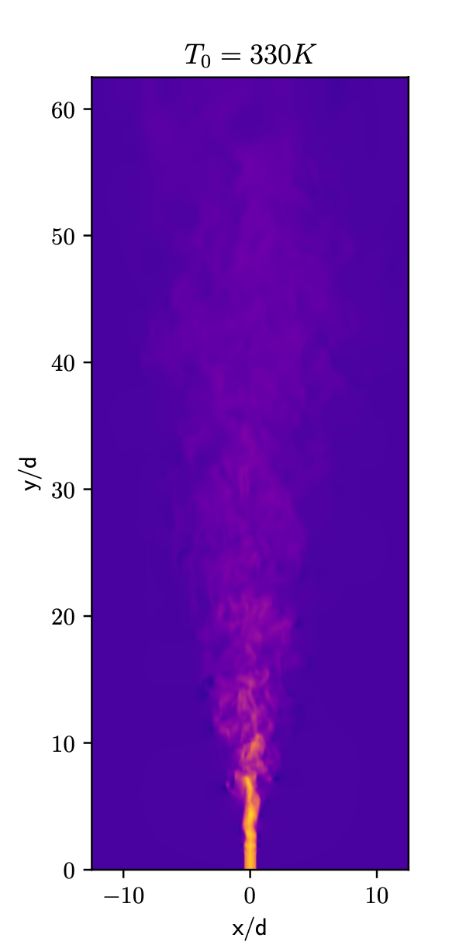
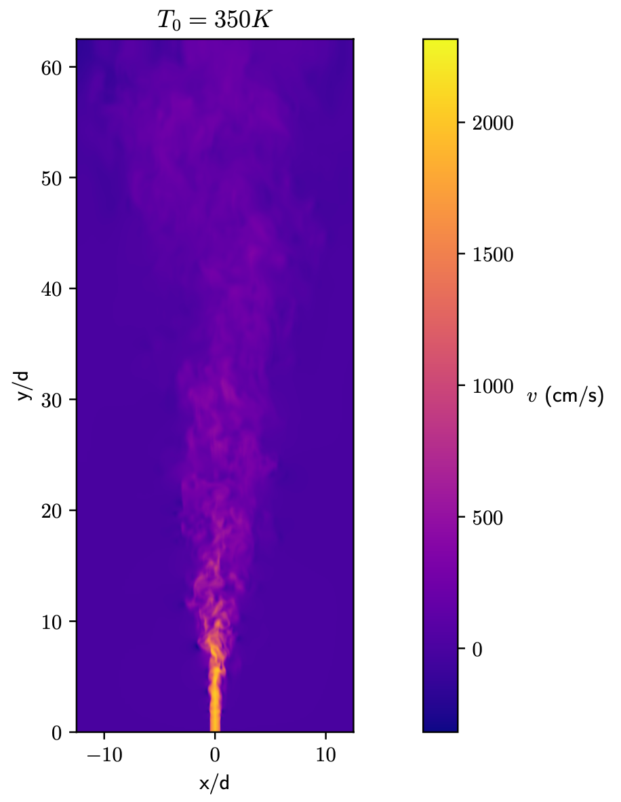
Data Collection
100 Plots saved per flowthrough length
Slices made either every 3 cm from y = 3 to 18 or every 5 cm from y = 5 to 50
Means calculated with last 200 plot files after 10 flowthroughs

Slide 27
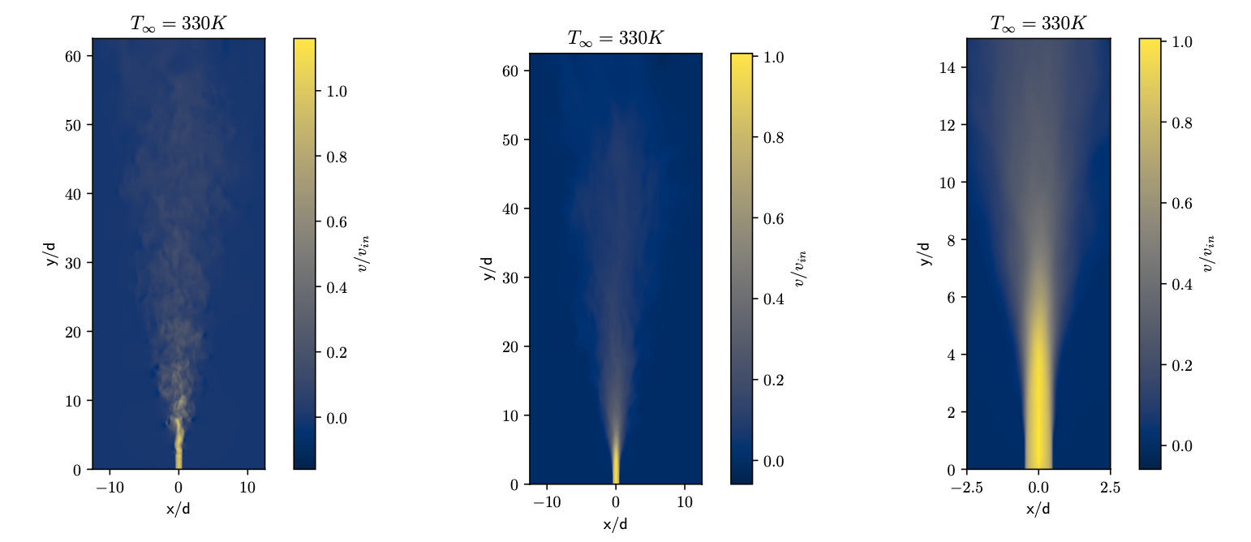
Isothermal Case:
Velocity Field
Potential Core approx. 7d

Slide 28
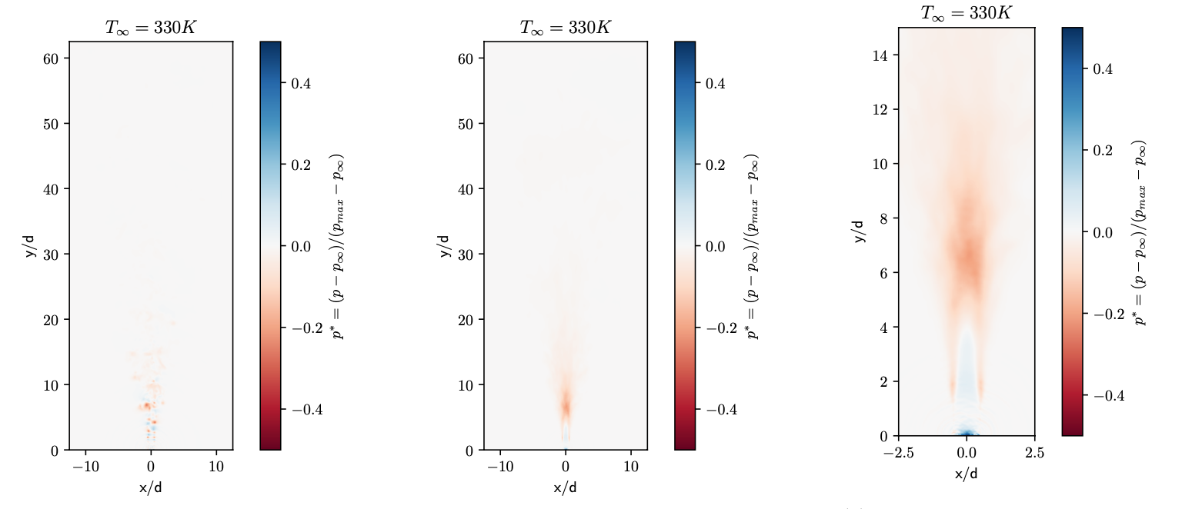
Isothermal Case:
Pressure Field
Axisymmetric pressure fluctuations limited to inlet

Slide 29
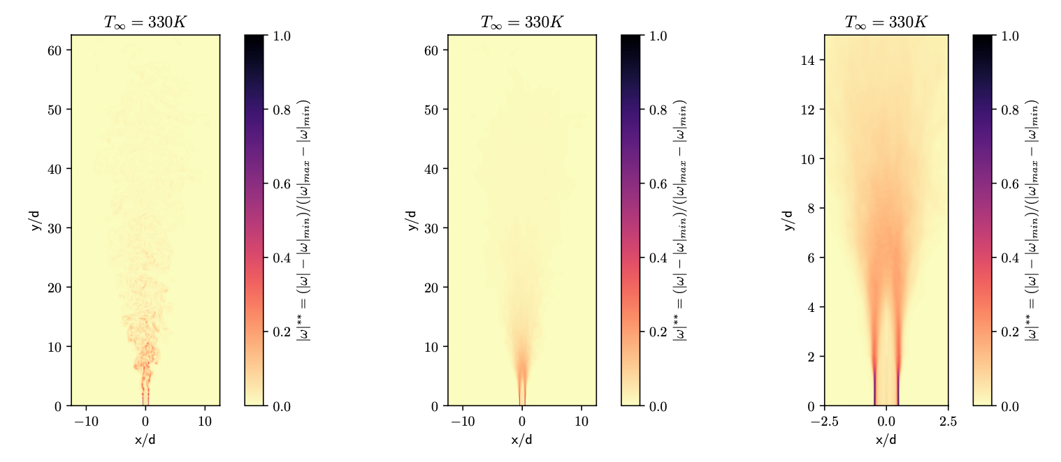
Isothermal Case:
Vorticity Field
Perturbations begin around 2d, with distinct vortices forming soon after
Nonlinear vortex interactions around 5d

Slide 30
Isothermal Case:
Velocity Profiles
Profiles begin to collapse into one curve in self-similar region.

Slide 31

Isothermal Case:
Centerline Scaling
Linear velocity decay and spreading rate
$B_{v}=3.69;C_{v}=0.122$

Slide 32
Isothermal Case:
Resolved Turbulent Kinetic Energy
Anisotropic turbulence akin to higher Mach compressible flows

Slide 33
Non-isothermal Cases:
Velocity Field
Much shorter potential core in 314 Case compared to other two

Slide 34
Non-isothermal Cases:
Pressure Field
Perturbations are more symmetric in 314 Case
Also, more intense earlier on in flow

Slide 35
Non-isothermal Cases:
Vorticity Field
314 Case has earlier vortex formation & stronger vortex pairing
Finer and more compact vorticity structures after potential core

Slide 36
Non-isothermal Cases:
Thermodynamic Decay
Peak specific heat shell around potential core of 314 Case => elevated levels remain downstream
Temp drops aggressively while density has more gradual transition

Slide 37
Non-isothermal Cases:
Centerline Decay
Peak in cp results in faster temp transition in 314 Case compared to 350
314 density transition slower than 350, but reaches same equilibrium with ambient

Slide 38
Non-isothermal Cases:
Near Field Velocity Profiles
Profiles don’t exhibit as clean of a collapse as isothermal case

Slide 39
Non-isothermal Cases:
Far Field Velocity Profiles
Even more spread than near field

Slide 40

Non-isothermal Cases:
Velocity Decay
Faster decay in 314 Case
314 Case: $B_{v}=2.92$
350 Case: $B_{v}=4.48$

Slide 41

Non-isothermal Cases:
Velocity Decay
More spreading in 314 Case
314 Case: $C_{v}=0.122$
350 Case: $C_{v}=0.115$

Slide 42
Non-isothermal Cases:
Resolved Turbulent Kinetic Energy
Increased anisotropy in 314 Case

Slide 43
Conclusions
Isothermal supercritical jet displays many similar qualities compared to ideal jets
Self-similarity collapse
Potential core length within typical ranges seen in literature
Main differences seen in linear decay rate/spreading rate and anisotropic TKE components
Non-isothermal case away from pseudo-boiling point is similar to isothermal case with minor differences noted across quantities of interest

Slide 44
Conclusions
Non-isothermal case involving pseudo-boiling point shows markedly different flow characteristics compared to other two cases => pseudo-boiling not only deviates flow from ideal behavior but also other supercritical flow regimes
Loss of clear self-similarity profile collapse in transition zone
Larger and more distinct vortex pairing with shorter potential core => increased Kelvin-Helmholtz like instability
Faster downstream decay but equivalent spreading rate compared to isothermal supercritical jet
Stronger anisotropy in resolved TKE => more intense mixing in transition region

Slide 45
Future Work
Work on methods to further incorporate real gas properties into LES SGS models
Study other supercritical regions around the pseudo-boiling point
Look at flow structure of more complicated fluid mixtures (multiple species)
Other unrelated projects
QSSA for combustion
LBM-hybrid for battery applications

Slide 46
This research was supported in part by an appointment with the National Science Foundation (NSF) Mathematical Sciences Graduate Internship (MSGI) Program sponsored by the NSF Division of Mathematical Sciences. This program is administered by the Oak Ridge Institute for Science and Education (ORISE) through an interagency agreement between the U.S. Department of Energy (DOE) and NSF. ORISE is managed for DOE by ORAU. All opinions expressed in this paper are the author's and do not necessarily reflect the policies and views of NSF, ORAU/ORISE, or DOE.
The research was performed using computational resources sponsored by the Department of Energy's Office of Energy Efficiency and Renewable Energy and located at the National Renewable Energy Laboratory.
This work was supported by the Department of Energy's Office of Science through the Exascale Computing Project (ECP), managed through Oak Ridge National Laboratory.
Acknowledgements

Slide 47
More Acknowledgements
Thank you to my wonderful advisors and committee members!!
Thank you to my family and friends!!!!

Slide 48
Questions?
Julia Ream, jream@math.fsu.edu

